Slide 1
Presentation Layer
Business Logic Layer
Data Access Layer

Slide 2
Presentation Layer
Business Logic Layer
Data Access Layer

Slide 3
Presentation Layer:
Also known as the user interface (UI) layer.
In Java, the UI layer is often implemented using technologies like JavaFX or Swing for desktop applications.
JavaServer Faces (JSF) or Java Servlets and JavaServer Pages (JSP) are commonly used for web-based UI development.
Presentation Layer
Business Logic Layer
Data Access Layer

Slide 4
Business Layer:
Also known as the logic layer or the domain layer.
Contains the core business logic of the application. It encapsulates the rules, processes, and operations that define how the application functions..
Presentation Layer
Business Logic Layer
Data Access Layer

Slide 5
Data Access Layer:
Sometimes referred to as the persistence layer or the data layer.
Handles the storage and retrieval of data from a data source, such as a database or a web service.
Interacts with the database or external services to perform CRUD (Create, Read, Update, Delete) operations.
Presentation Layer
Business Logic Layer
Data Access Layer

Slide 6
Presentation Layer
Business Logic Layer
Data Access Layer

Slide 7


Presentation Layer
Business Logic Layer
Data Access Layer

Slide 8
Potential drawbacks and challenges:
Tight Coupling.
Lack of Flexibility.
Performance Overhead.
Monolithic Nature.
Limited Scalability.
Lack of Domain Focus.
Violate the SOLID principles.
Presentation Layer
Business Logic Layer
Data Access Layer

Slide 9

Inbound Adapter
IoC
Inversion of Control
Inbound Port
Interface
Presentation Layer
Core
Business Logic Layer
Outbound Port
Interface
Data Access Layer
Outbound Adapter

Slide 10
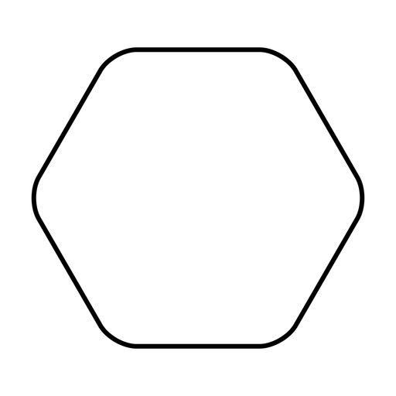
Inbound Adapter
Adapters
Inbound Port
Inbound Adapter
Core
Inbound Port
Domain
Core
Entity
Outbound Port
Outbound Port
Outbound Adapter
Outbound Adapter

Slide 11





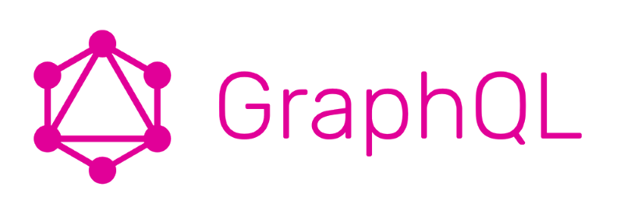
Adapters
Rest Adapter
Core
MongoDB Adapter
Inbound Port
Domain
Entity
Outbound Port
Graphql Adapter
JPA Adapter

Slide 12
Adapters
Rest Adapter
Core
MongoDB Adapter
Inbound Port
Domain
Entity
Outbound Port
Graphql Adapter
JPA Adapter

Slide 13
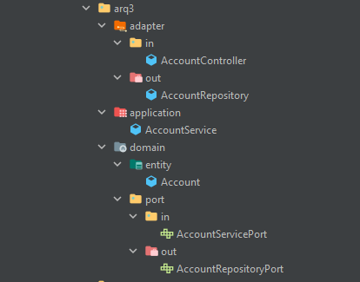

Slide 14
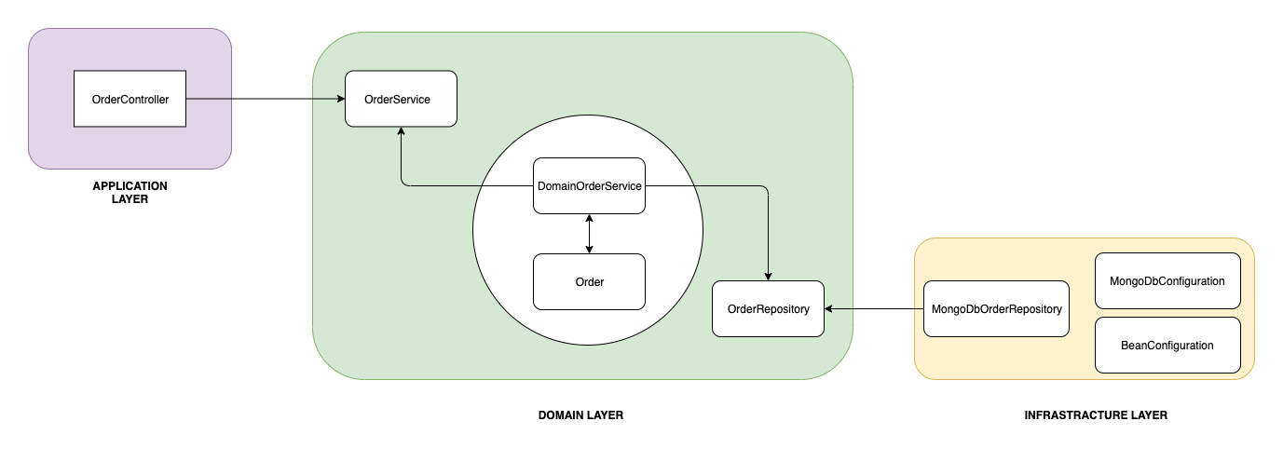

Slide 15
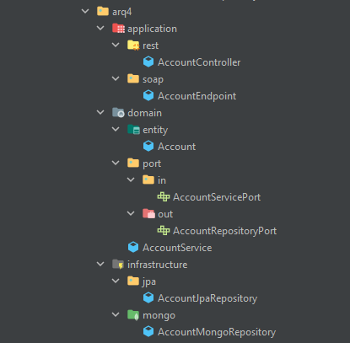

Slide 16
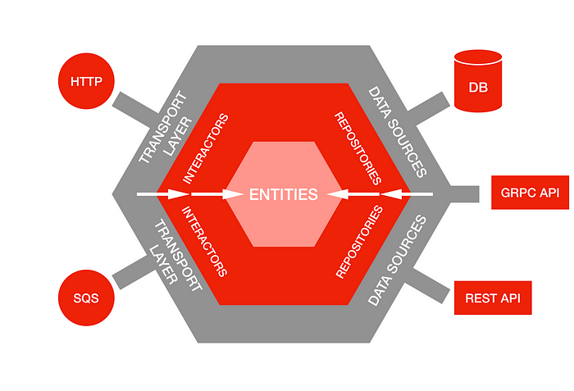

Slide 17
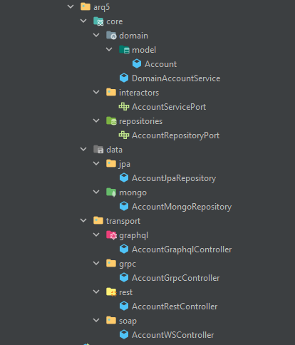

Slide 18
Adapters
Ubiquitous language
Rest
Core
MongoDB
Interactors
Use Cases
Domain
Model
Repositories
CRUD
Graphql
JPA

Slide 19
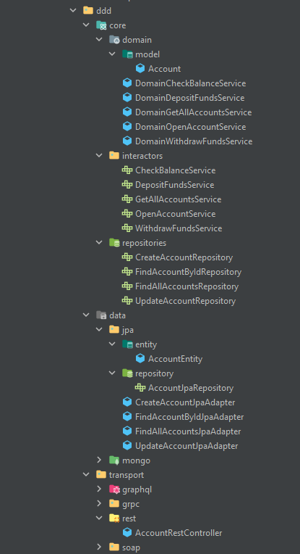
Adapters
Rest
Core
MongoDB
Interactors
Use Cases
Domain
Model
Repositories
CRUD
Graphql
JPA

Slide 20
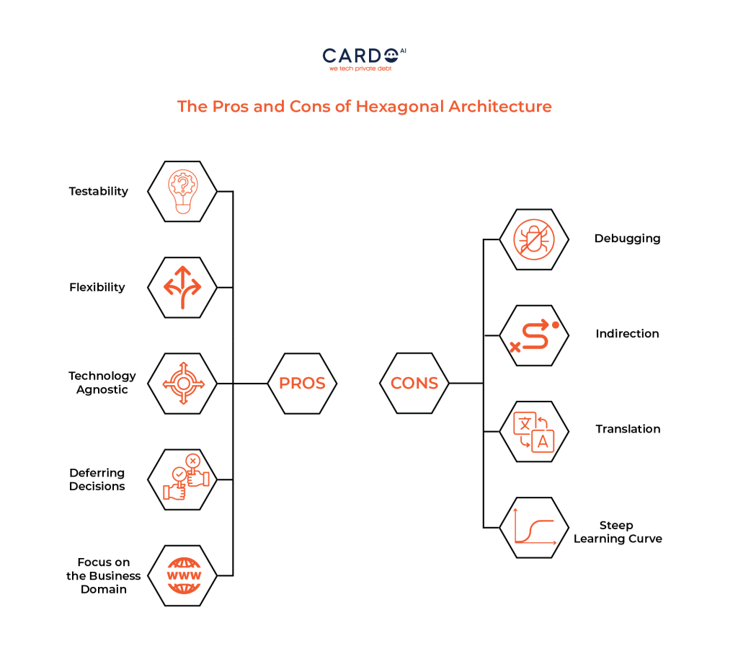

Slide 21
Inbound port / Interactors
Use Cases
SmsRestController
SendSmsService
Transport Layer
DomainSendSmsService
Domain - Models
Business Logic
Sms
Outbound port / Repositories
CRUD Operations
CreateSmsRepository
Core Layer
CreateInfoBipSmsAdapter
CreateTwilioSmsAdapter
SmsConfig
Data Source Layer

Slide 22
Acknowledgments & References
https://www.dineshonjava.com/software-architecture-patterns-and-designs/
https://www.dineshonjava.com/a-practical-example-of-hexagonal-architecture-in-java/
https://netflixtechblog.com/ready-for-changes-with-hexagonal-architecture-b315ec967749
https://medium.com/bancolombia-tech/clean-architecture-aislando-los-detalles-4f9530f35d7a
https://www.baeldung.com/hexagonal-architecture-ddd-spring#hexagonal
https://thedomaindrivendesign.io/developing-the-ubiquitous-language/
https://www.wrike.com/blog/what-is-a-use-case/
https://www.youtube.com/watch?v=IZWLnn2fNko
https://www.youtube.com/watch?v=wYWh5rg88UE
https://cardoai.com/what-is-hexagonal-architecture-should-you-use-it/

